Slide 1


Type III Radio Burst Characteristics of SEP events
A Tale of SEPs with Bryan Yamashiro

Slide 2
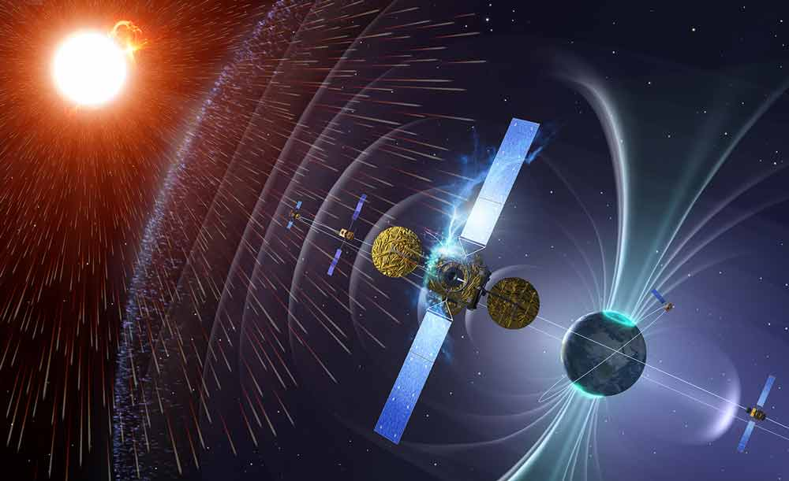
Solar Energetic Particles
High energy protons, electrons, and other nuclei [1]
Energies from keV to GeV
Up to ~0.80c
Acc. Mechanism (?):
Shock acceleration
Magnetic reconnection
Hazards to humans and assets in space and on Earth
ee.co.za

Slide 3
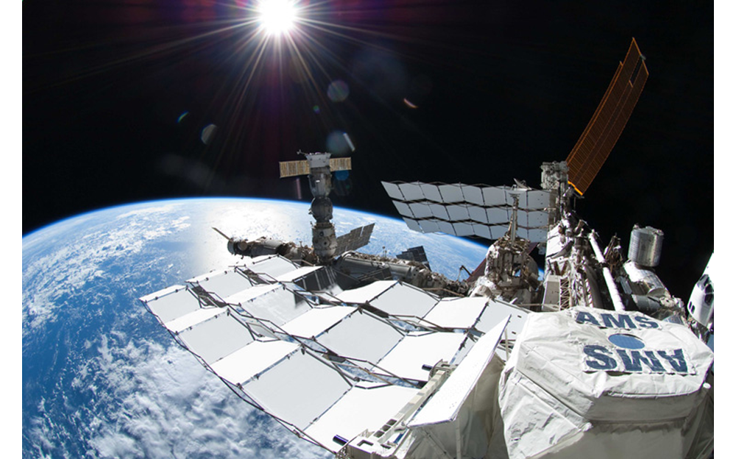
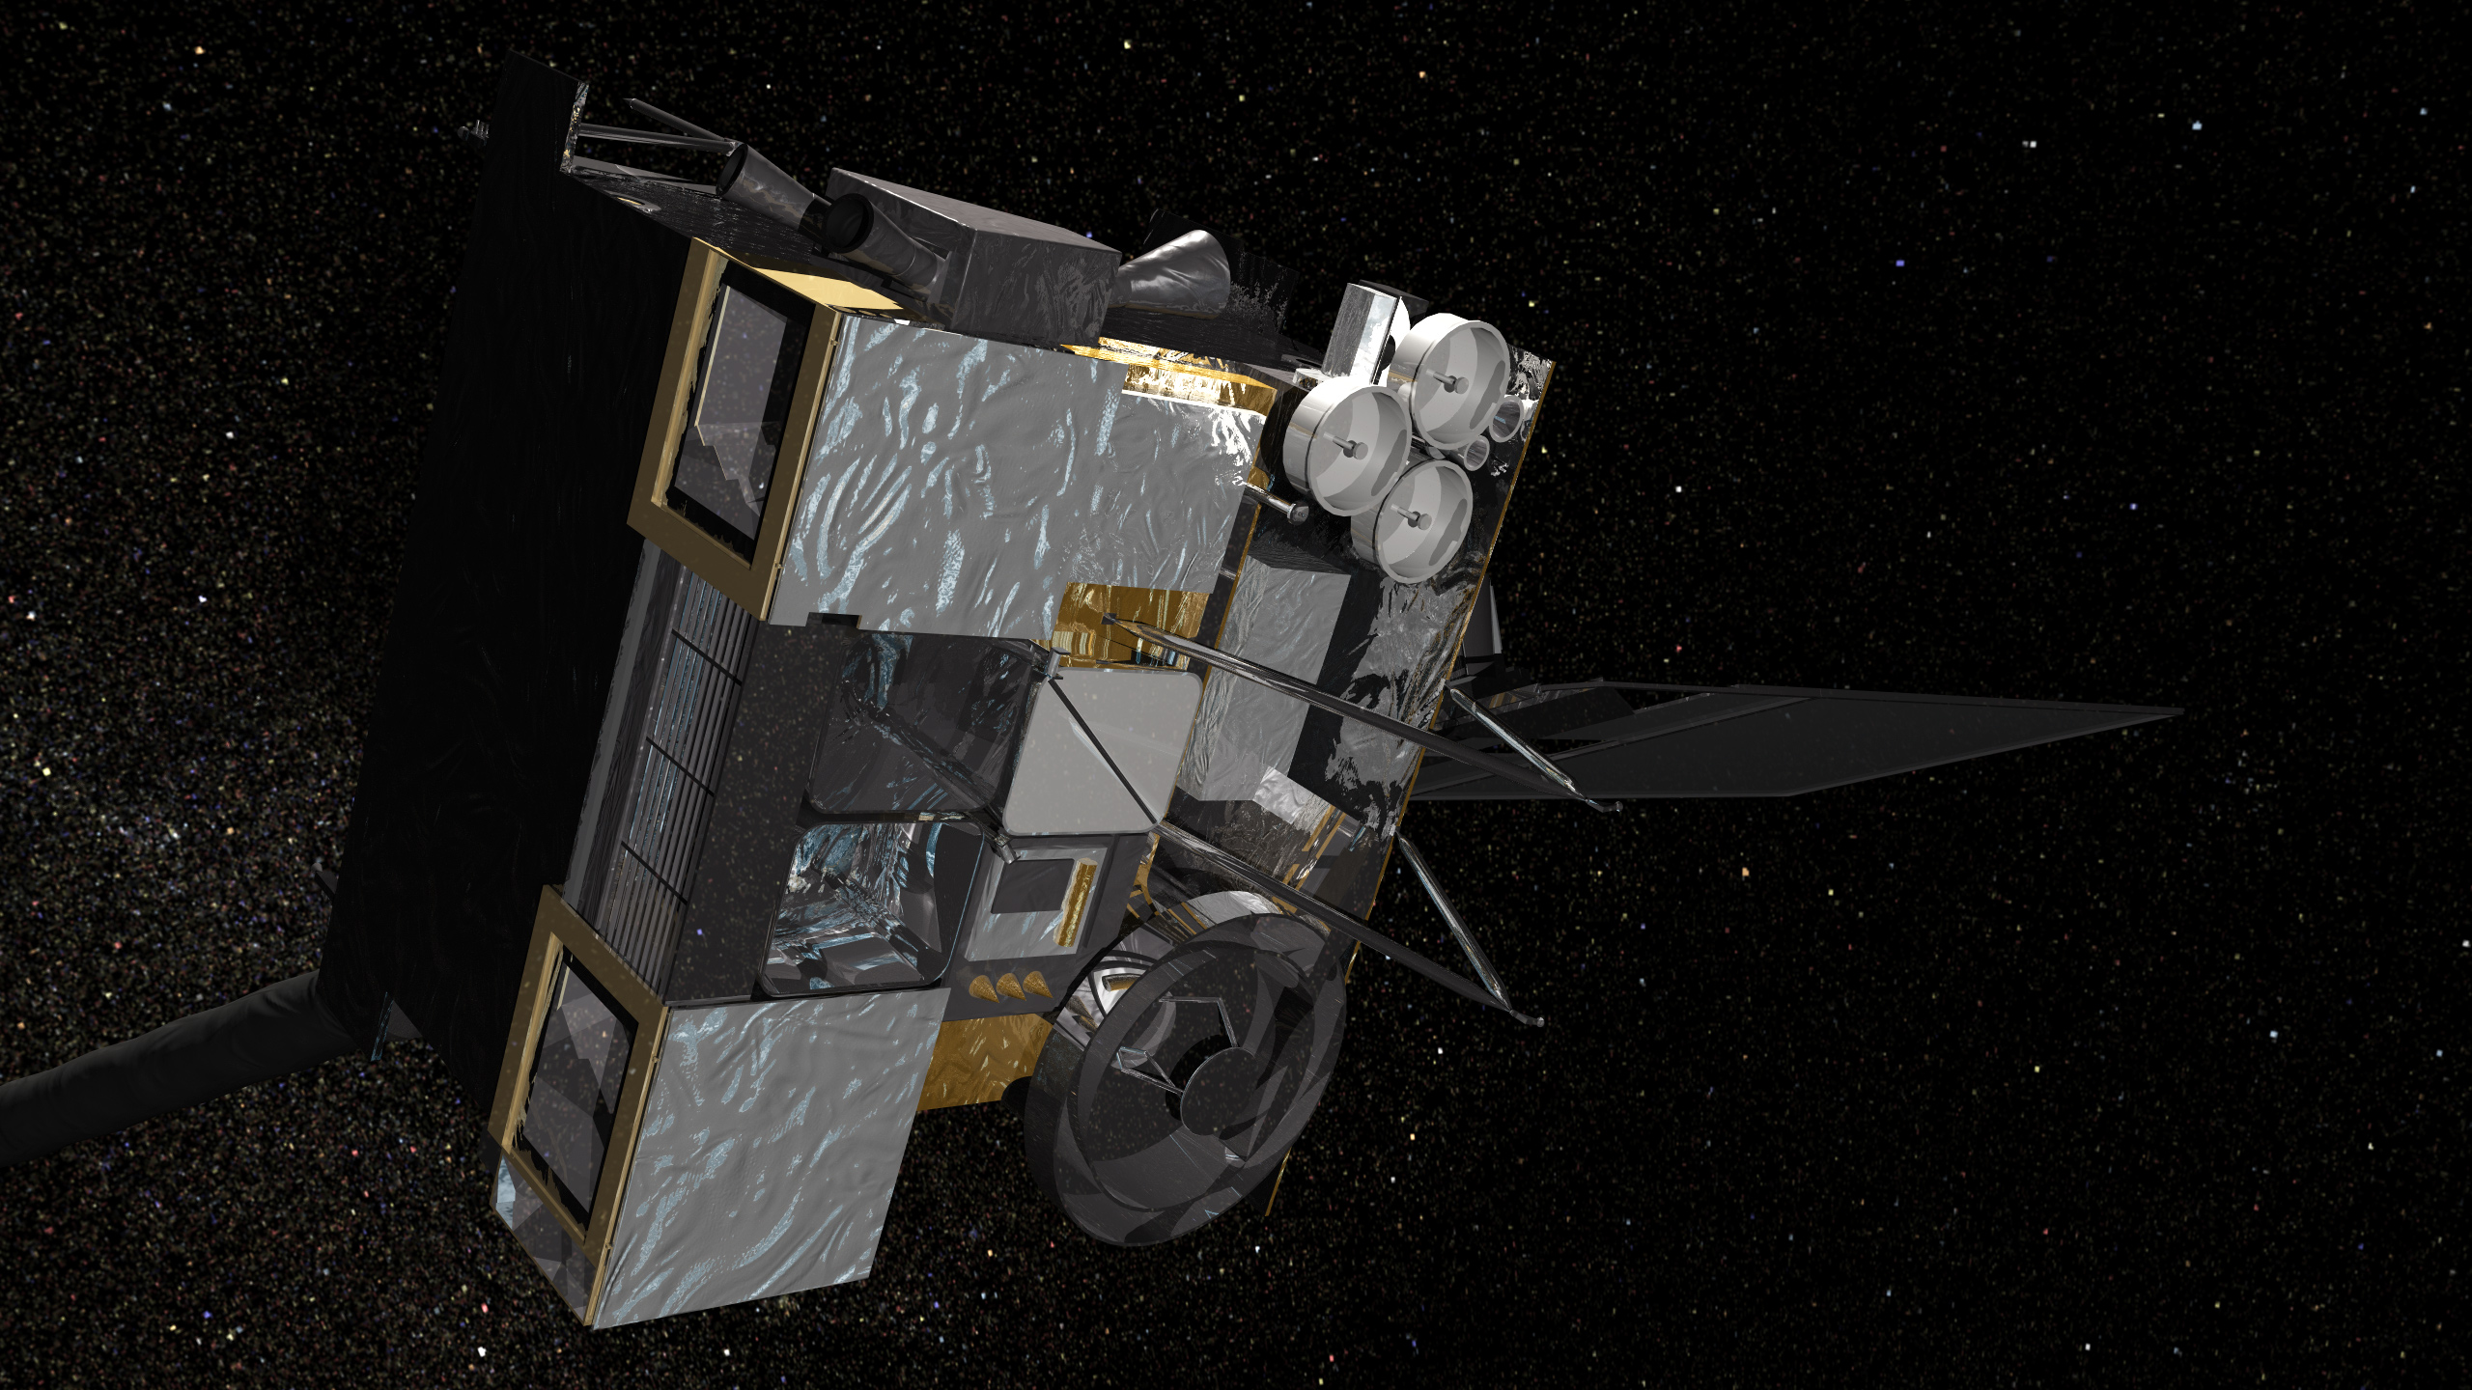
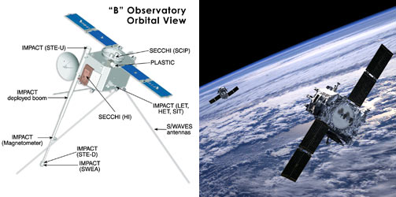
Solar Energetic Particle Detection
Alpha Magnetic Spectrometer
125+ MeV
GOES-13/15 W
10-700 MeV
STEREO-A,B
60-100 MeV
Neutron Monitors
0.5-20 GeV
ams.nasa.gov
nasa.gov

Slide 4
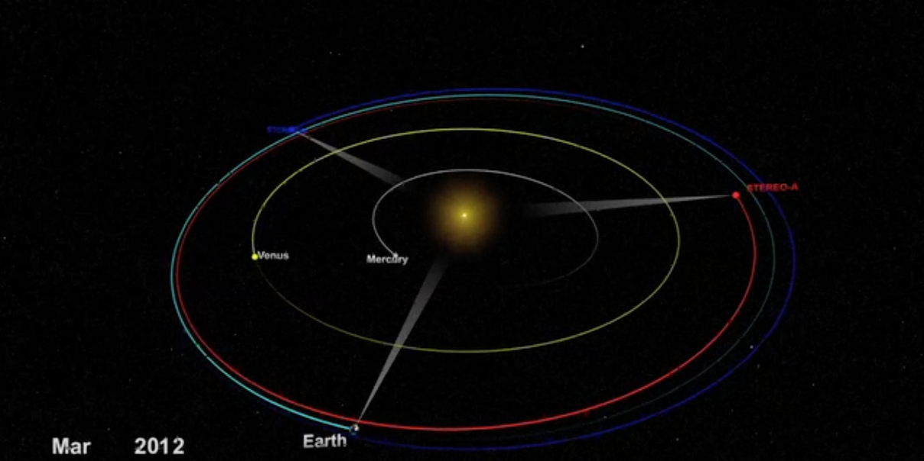
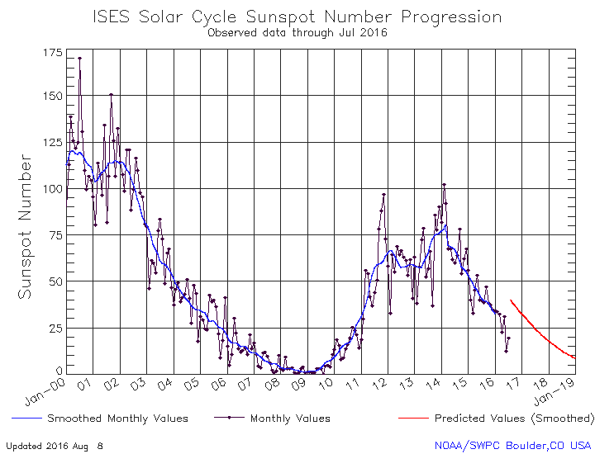
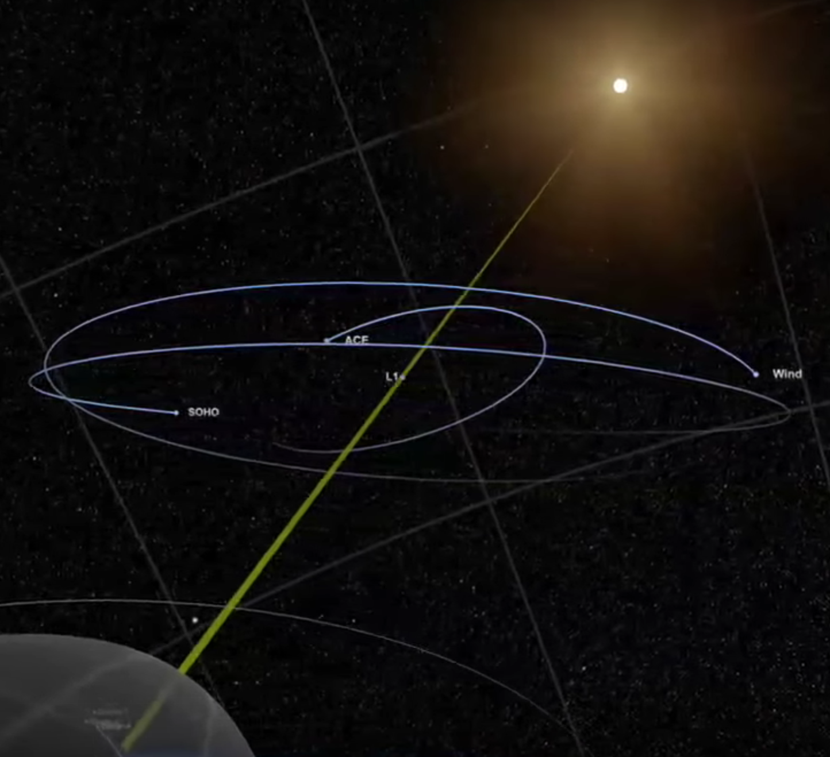
Events in Sample
nasa.gov
STEREO B
STEREO A
L1
L1
EARTH
EARTH
swpc.noaa.gov
June 7, 2011 to September 10, 2014 (Sunspot Cycle 24)
~25 individual 100+ MeV SEP events seen by GOES
5 backside events
Troves of event parameters

Slide 5
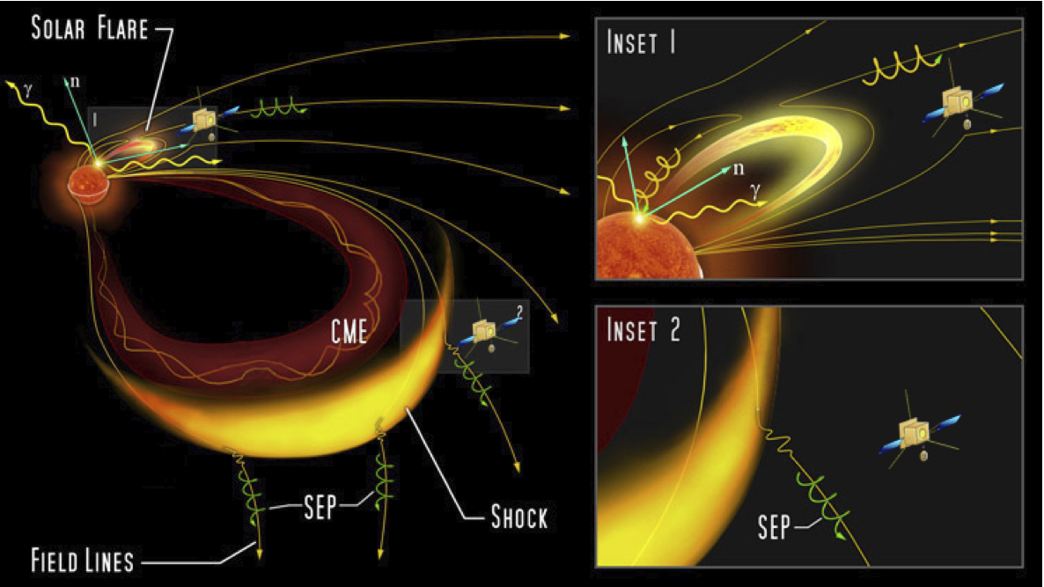

Evolution of SEP Events
1 & 2
3
4
inspirehep.net
Parameters and observations exhibited in every >100 MeV SEP event

Slide 6
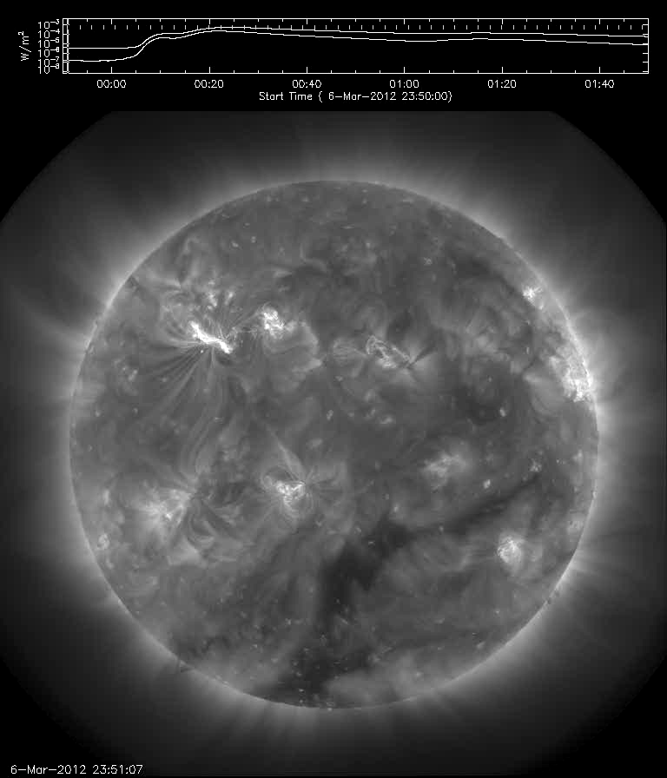
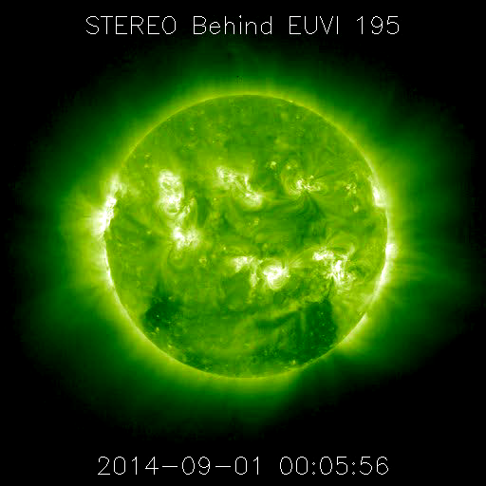
Intense EUV Flare
SDO 193A : Frontside
STEREO B : Backside
sdowww.lmsal.com
stereo-ssc.nascom.nasa.gov
12 M-class, 8 X-class, 5 Backside
Sudden brightness and energy release [1]

Slide 7
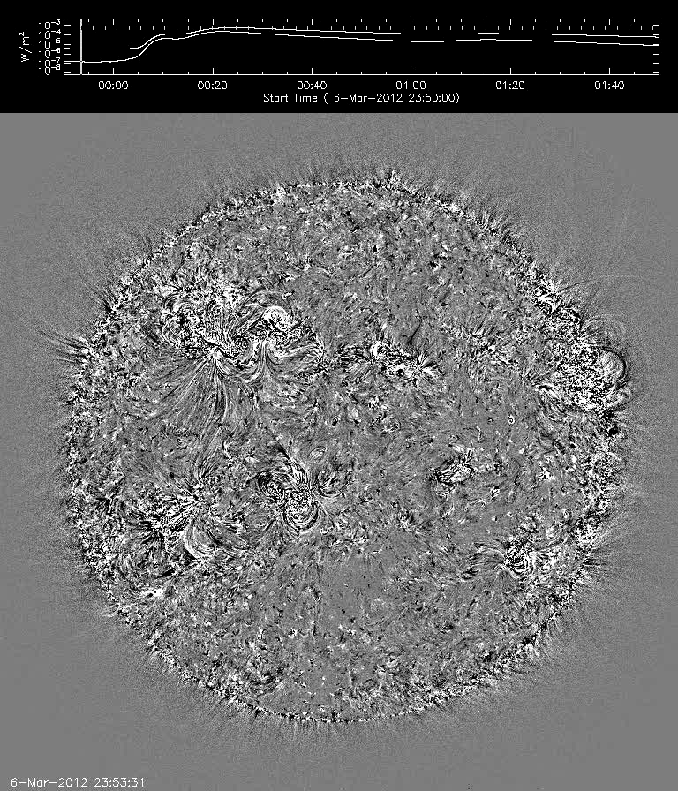
Large-scale Coronal Propagating Front (193 A)
Running Difference
Background Difference
lmsal.com
Wave propagating along the surface (EIT Waves) [2]
743 – 1307 km/s (Until ~July 2012) [3]
Average: 910 km/s

Slide 8
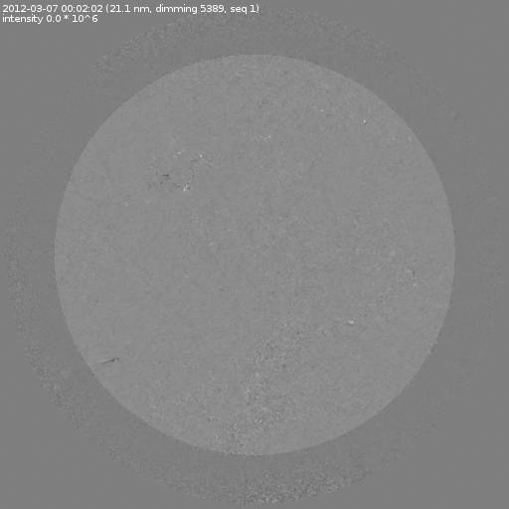
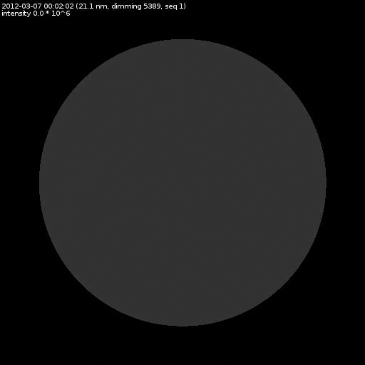
Dimming and EIT Waves
SDO Difference Images: 211 A
Decreases in soft X-rays and EUV images [4]
Caused by (?):
Decrease in plasma density [4]
Change in temperature [3]
SEP Events
Dimming Intensity [5]
-132 to -2952 DN/s * (10^3)
Average: -1152 DN/s * (10^3)
Dimming Area
0.8 (limb) to 372.1 km^2 * (10^9)
Average: 142 km^2 * (10^9)
solardemon.oma.be

Slide 9
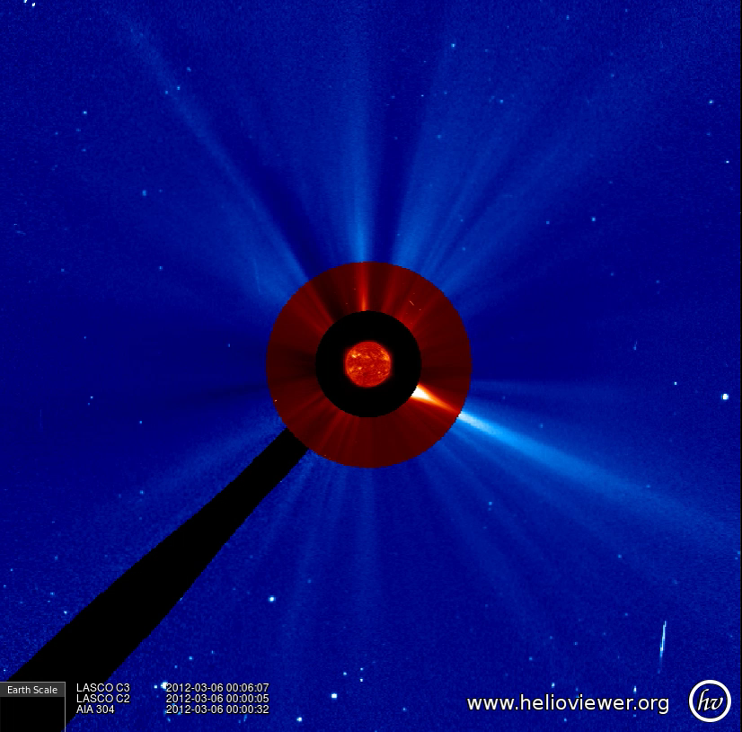
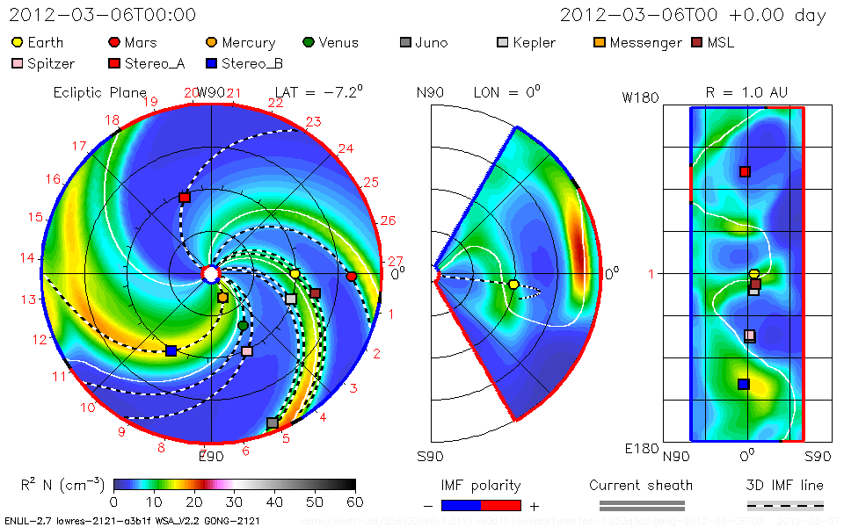
Coronal Mass Ejection
Ejection of energetic particles, plasma and magnetic fields [1]
Fast CME Speeds
575 – 2684 km/s
Average: 1543 km/s
650 – 2500 km/s
Average: 1491 km/s
All were “Halo” CMEs seen from SOHO [6]
helioviewer.org
CDAW [6] DONKI [7]
kauai.ccmc.gsfc.nasa.gov

Slide 10
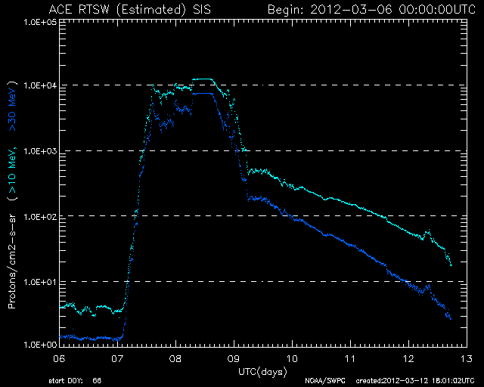
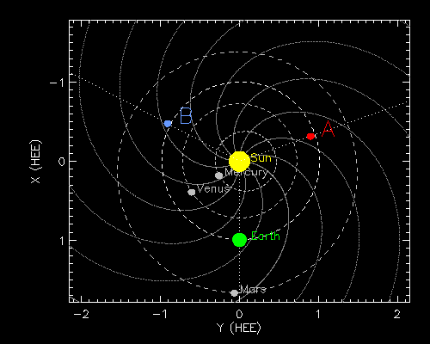
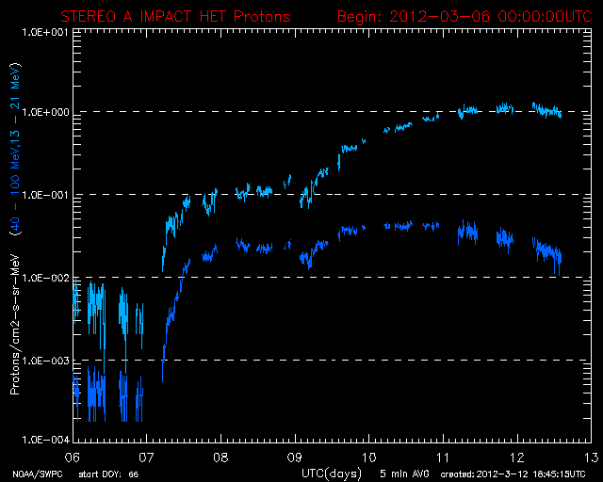
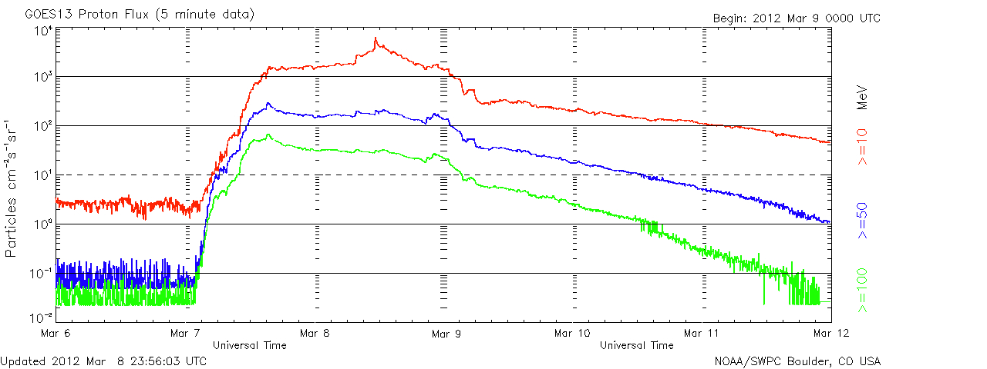
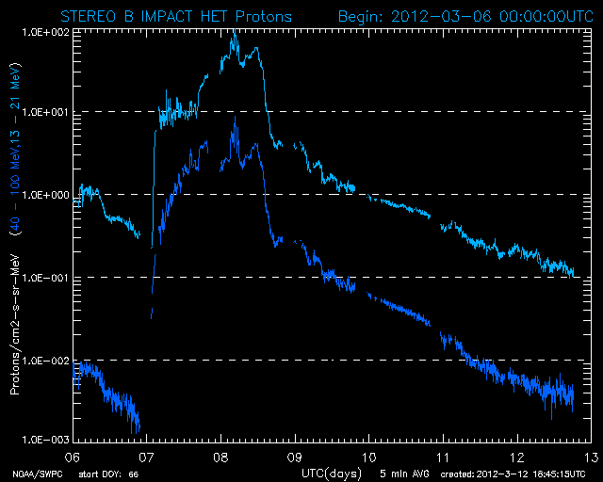
SEP Detection in Space
B
A
L1
stereo.ssl.berkeley.edu
swpc.noaa.gov
>100 MeV flux above 10^-1 pfu
Widespread detection of particle flux seen at Earth and both STEREO spacecraft

Slide 11
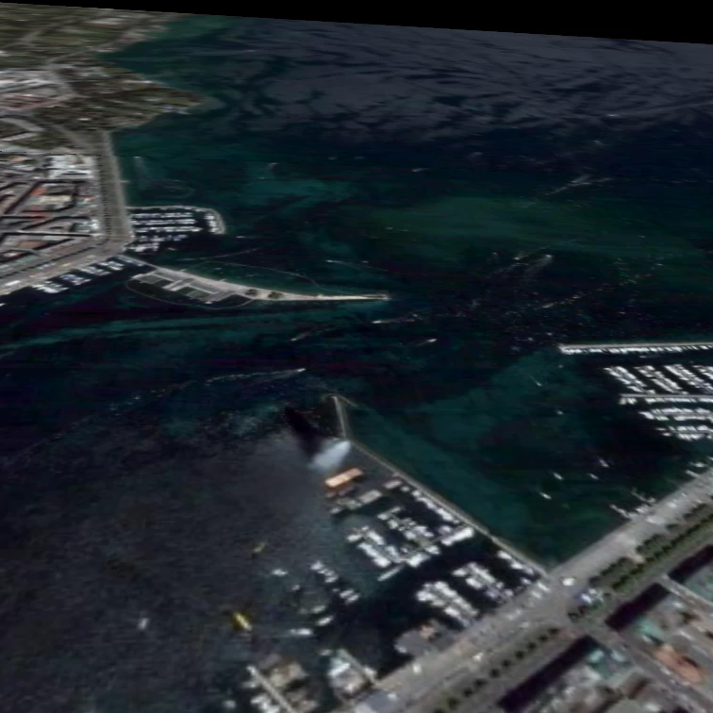
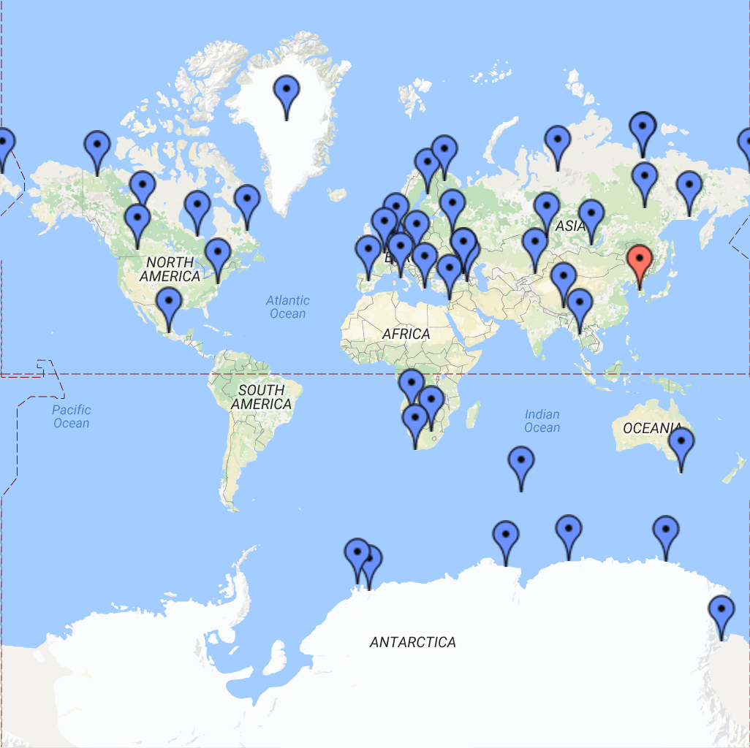
Ground Level Enhancements
High energy (>500 MeV) primary particles interact with air molecules causing cascades of secondary particles [8]
Byproducts of air showers are detected by neutron monitors that are distributed across the world
Sample contains a GLE: May 17, 2012
About a dozen or less GLEs every decade
71 GLEs since 1942
astro.uchicago.edu
nmdb.eu

Slide 12
Flare Location
Dramatic East-West bias
West: 18
East: 7
No North-South bias
North: 12
South: 13
Frontside detection provided by GOES X-ray detector
Backside flare locations using STEREO-A,B and Carrington rotation
Long.= arctan(z/(x^2+y^2)^-1)
Lat.= arctan(y/x)

Slide 13
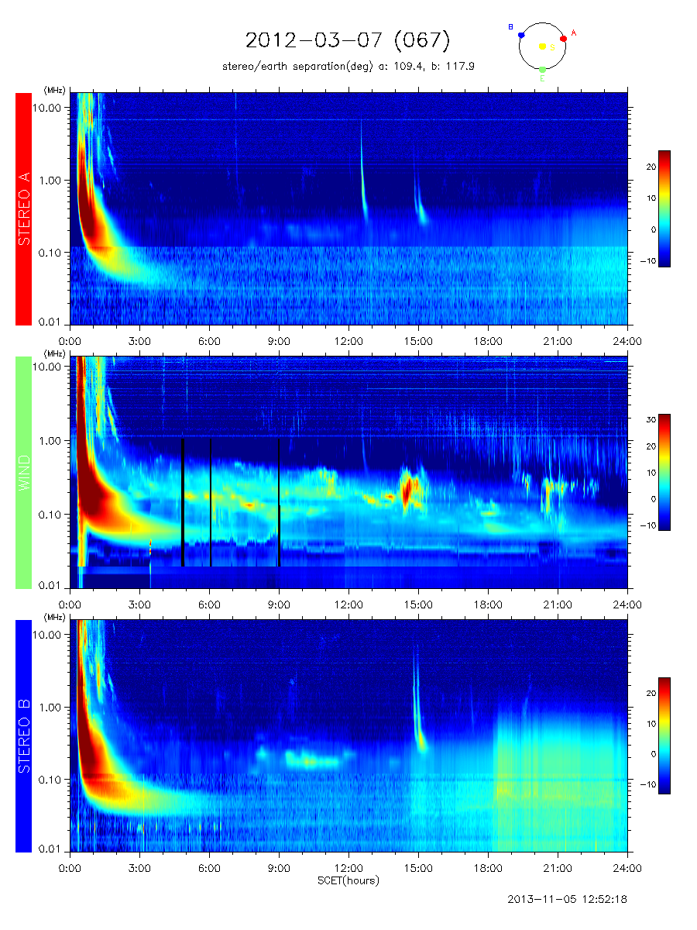
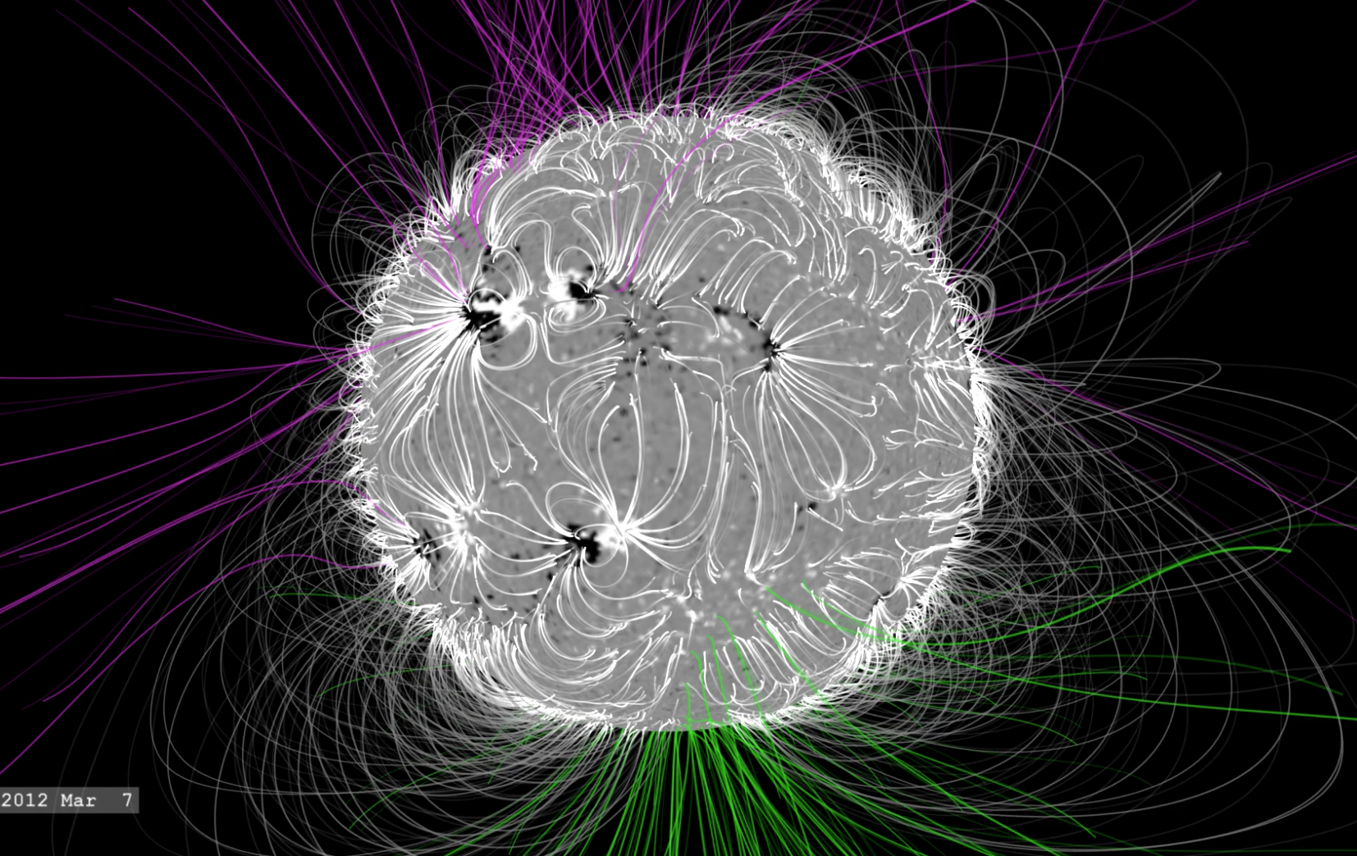
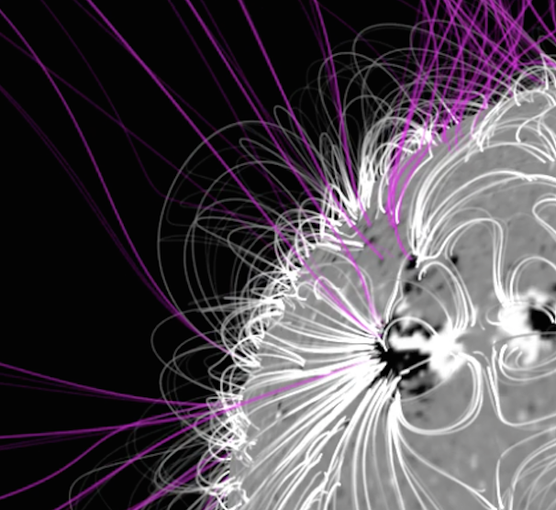
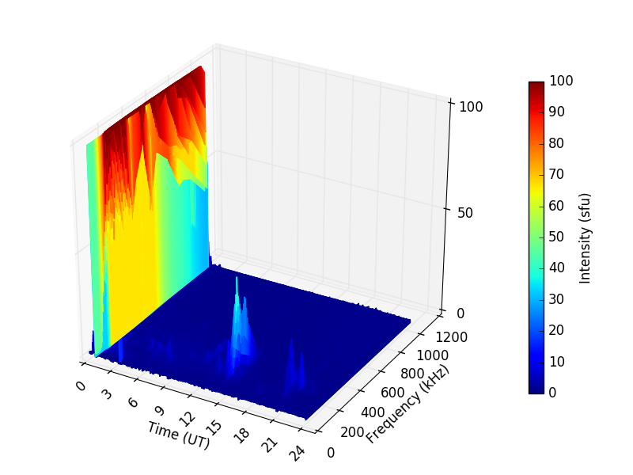
Type III Radio Bursts
svs.gsfc.nasa.gov
Radio waves ~3 kHz to ~15 MHz
Produced by stream of electrons that create Langmuir waves that interact with plasma [9]
Acceleration mechanism (?):
Flare/Shock
Mechanism following open field lines from source location
swaves.gsfc.nasa.gov

Slide 14
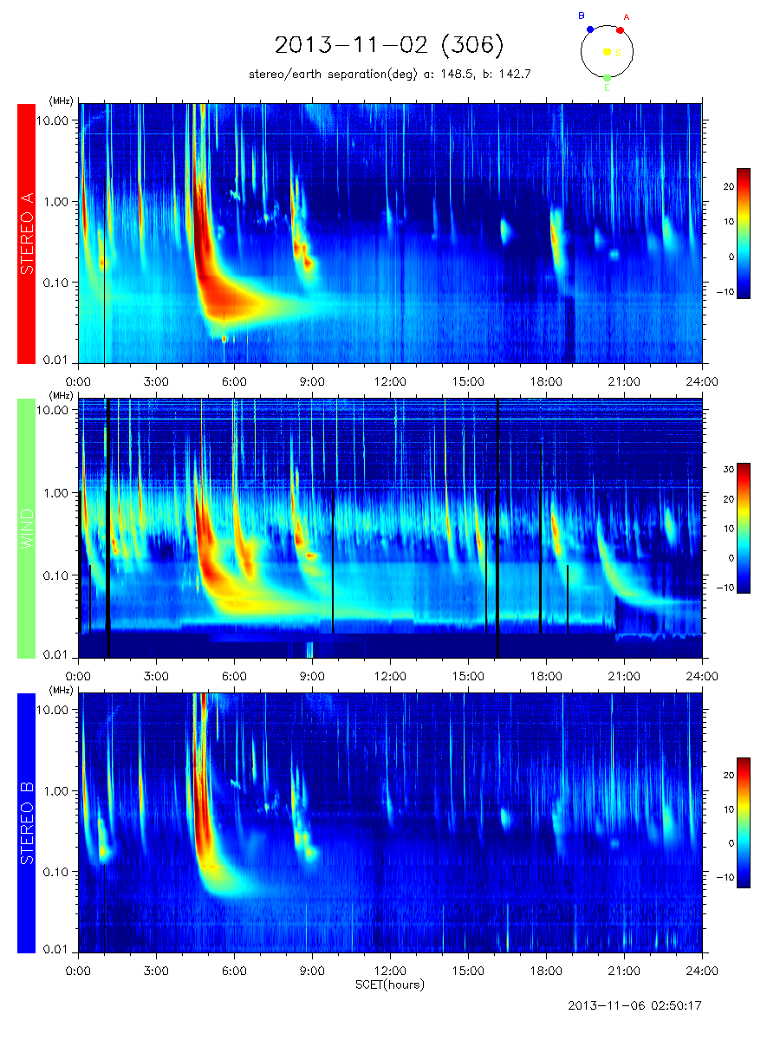
Why these Frequencies?
~1 MHz – Onset time
~20 kHz – Long duration of burst
Both are necessary to analyze the entirety of each event (why not all?)
Threshold Intensity: 15 sfu
Radiant flux (intensity) of a surface per unit frequency
swaves.gsfc.nasa.gov

Slide 15
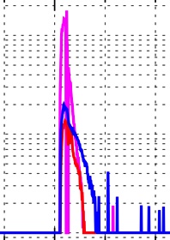
Type III Intensity and Duration
Onsets 10 MeV GOES 15 min [WC] – >7 hr [BS]
25/25 100 MeV Events exhibit low frequency long duration TIII Radio Bursts
~8/11 NOAA 10 MeV Events
Backsides/Filament Eruptions
Wind Intensity: 20 – 198 sfu
Durations: 46 min – 2 hr 56 min
All Spacecraft Average Durations: 4 hr 7 min

Slide 16
Fluence vs. Proton Peak Intensity [preliminary!]
Fluence = Intensity (sfu) x Duration (s)
Radiant flux (intensity) of a surface per unit frequency over a duration
Needs a directionality/connectivity parameter due to morphology of proton flux intensities
Higher fluence shows slight trends of higher proton flux peaks, heightened correlation at higher energies

Slide 17
CME Speed and Dimming Intensity
Poor correlation against CME speeds
Slight correlation with dimming intensity
Low coronal and/or photosphere activity?

Slide 18
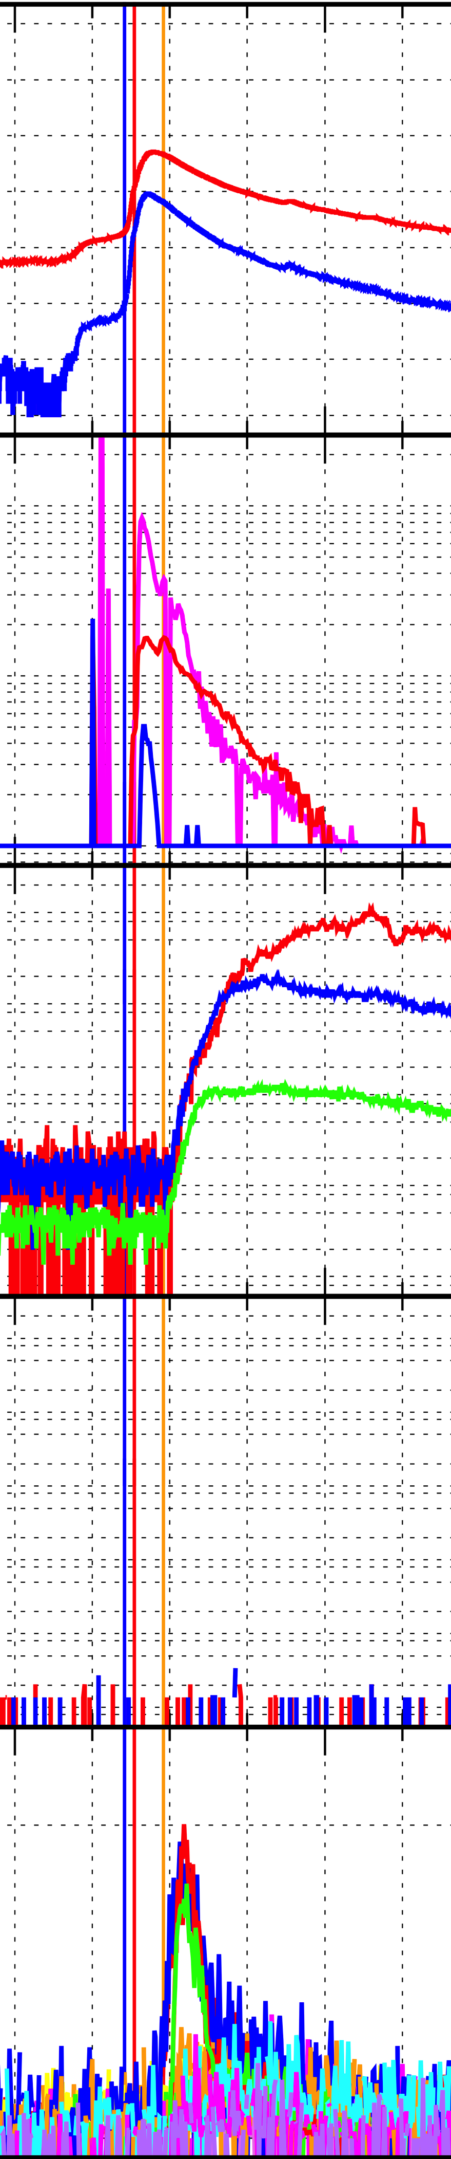
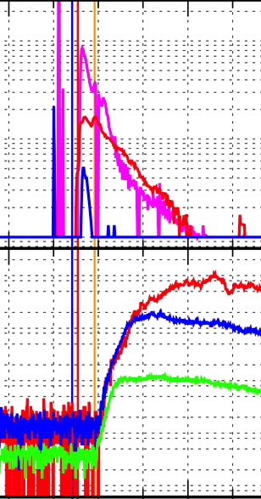
Type III’s for Space Weather SEP Predictions
Forecast Time
15 min
10 MeV onset
Well connected forecast

Slide 19
Type III’s for Space Weather SEP Predictions (continued)
Forecast Time
7 hr 15 min
10 MeV onset
Backside resolution

Slide 20
Type III’s for Space Weather SEP Predictions: GLE
NO TIII DATA
GLEs 65 – 71 (2003-2012) show preceding long duration type III radio bursts

Slide 21
What’s Next?
Connectivity coefficient for fluence
Thought experiment: Four events at different longitudes of equal event parameters
Viewing from Earth introduces directionality/connectivity bias
Fluence = Intensity x duration x [coefficient]
Geomagnetic Storms
TIII vs. DST/Kp
Catalog Type III Radio Bursts

Slide 22
Conclusions
25 SEP events between June 2011 and Sept 2014
All events exhibit long duration type III radio bursts
12 M-class, 8 X-class, 5 Backside
EIT waves averaging 910 km/s
CME speeds averaging 1500 km/s and all were “Halo”
Dimming average intensities of -1152 DN/s * (10^3) and an average area of 142 km^2 * (10^9)
Westward bias SEP flux bias at 100 MeV
25/25 100 MeV Events exhibit low frequency long duration TIII Radio Bursts
TIII forecast times of 5 min [WC] – >7 hr [BS]
X-ray intensities (solar flares) don’t fully explain the flux of particles and is blind to backside events

Slide 23
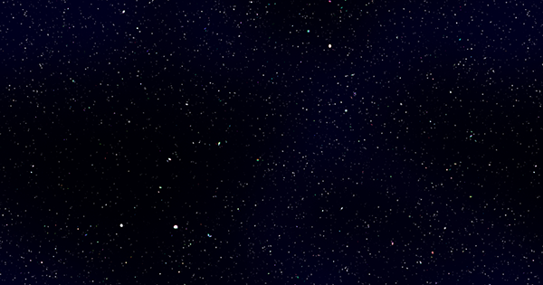

Acknowledgements
Special thanks to my mentor Dr. Richard Fisher, SESI coordinators, CCMC, various scientists, and peers.
CDAW CME Catalog
This CME catalog is generated and maintained at the CDAW Data Center by NASA and The Catholic University of America in cooperation with the Naval Research Laboratory. SOHO is a project of international cooperation between ESA and NASA.
SEP with Me!
A tale of science with Bryan Yamashiro

Slide 24
References
[1] Christian, E. R. (n.d.). NASA's Cosmicopia. Retrieved August 10, 2016, from http://helios.gsfc.nasa.gov/
[2] Thompson, B. J., & Myers, D. C. 2009, ApJS, 183, 225
[3] Nitta, N. V., Schrijver, C. J., Title, A., & Liu, W. 2013, ApJ, 776, 58
[4] Hudson, H.S., L.W. Acton, and S.L. Freeland. A long-duration solar flare with mass ejection and global consequences. Astrophys. J., 470, 629, 1996, DOI: 10.1086/177894.
[5] Emil Kraaikamp and Cis Verbeeck. J. Space Weather Space Clim., 5 (2015) A18, DOI: http://dx.doi.org/10.1051/swsc/2015019
[6] N. Gopalswamy, S. Yashiro, G. Michalek, G. Stenborg, A. Vourlidas, S. Freeland, and R. Howard,The SOHO/LASCO CME Catalog, accepted for the publication in Earth, Moon, and Planets
[7] https://kauai.ccmc.gsfc.nasa.gov/DONKI/search/
[8] J.A. Simpson, “Cosmic Radiation Neutron Intensity Monitor”, Annals of the Int. Geophysical Year IV, Part VII, Pergamon Press, London, p. 351, 1958
[9] Cane, H. V., Erickson, W. C., Prestage, N. P.: 2002, J. Geophys. Res. 107, A101315(doi:10.1029/2001JA000320).

Slide 25
Extra Slides

Slide 26
Open Field Lines

